Slide 1
传输层服务

Slide 2
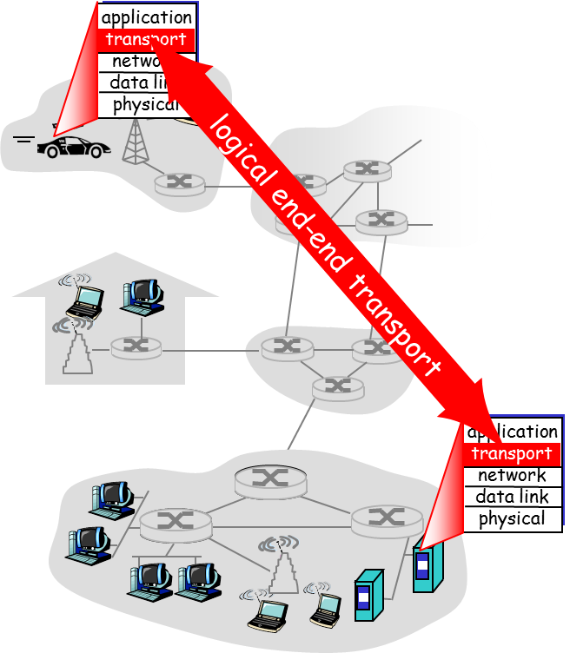
Transport services and protocols
provide logical communication between app processes running on different hosts
transport protocols run in end systems
send side: breaks app messages into segments, passes to network layer
rcv side: reassembles segments into messages, passes to app layer
more than one transport protocol available to apps
Internet: TCP and UDP

Slide 3
Transport vs. network layer
Household analogy:
12 kids sending letters to 12 kids
processes = kids
app messages = letters in envelopes
hosts = houses
transport protocol = Ann and Bill
network-layer protocol = postal service
network layer: logical communication between hosts
transport layer: logical communication between processes
relies on, enhances, network layer services

Slide 4
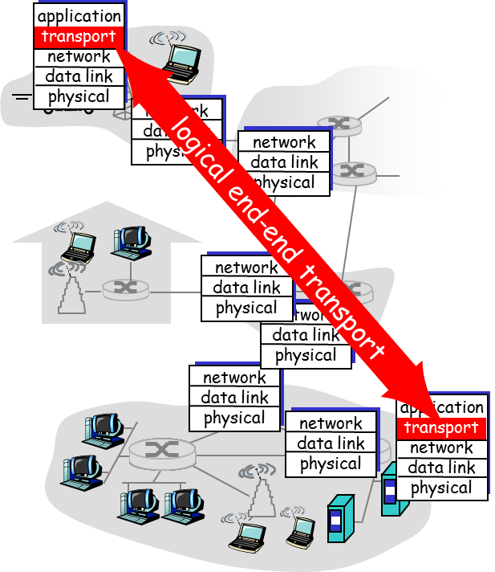
Internet transport-layer protocols
reliable, in-order delivery (TCP)
congestion control
flow control
connection setup
unreliable, unordered delivery: UDP
no-frills extension of “best-effort” IP
services not available:
delay guarantees
bandwidth guarantees

Slide 5
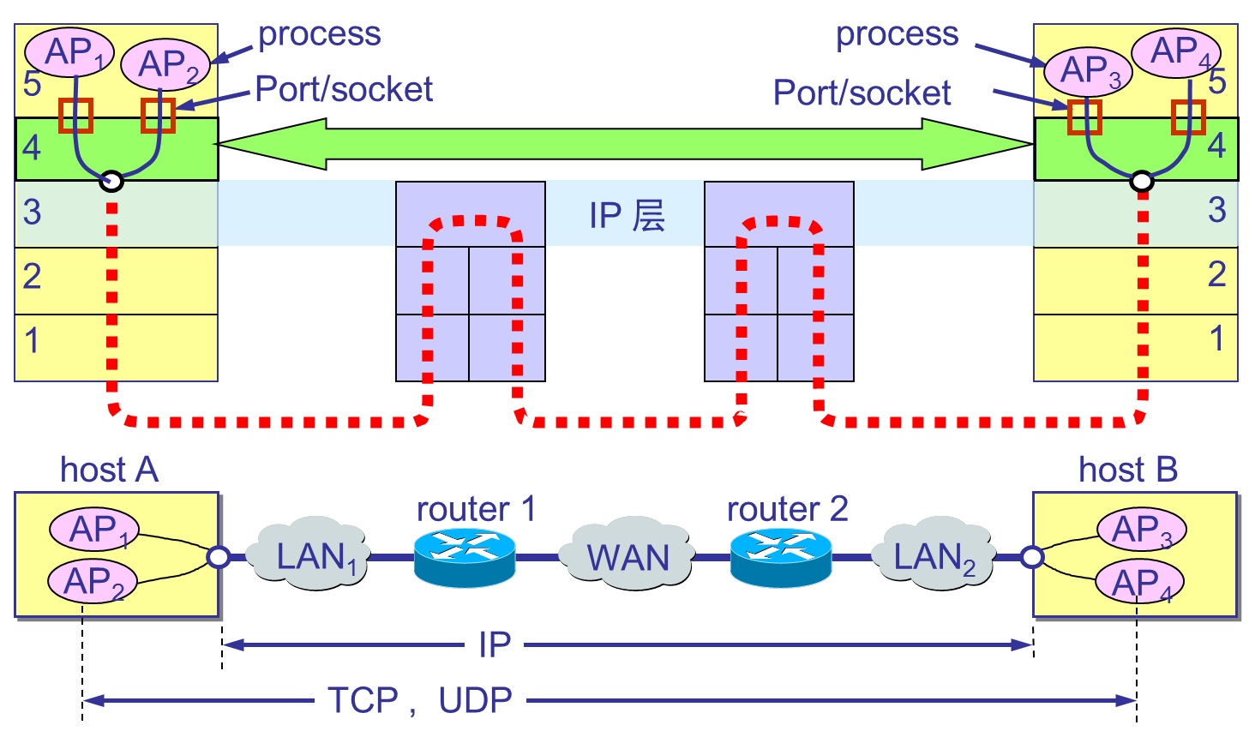
Internet transport-layer protocols

Slide 6

Summary
Transport services
Internet transport-layer protocols

